Slide 1
Evolutionary Algorithms: An implementation Artificial Intelligence – Innovative Assignment
17BCE001 Aaryan Gupta
17BCE028 Hamza Abubakar
17BCE062 Mohil Patel

Slide 2

Evolutionary Algorithms
Inspired from natural biological evolution in terms of reproduction, mutation etc.
“Survival of the fittest”
Global Optimization Approach
Resourceful w.r.t growing complexity in real-world problems
Part of the modern heuristic approach to given problems
Huge population + Limited amount of resources

Slide 3
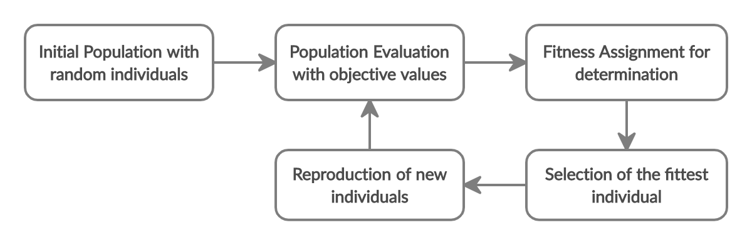
Overview of an Evolutionary Algorithm

Slide 4
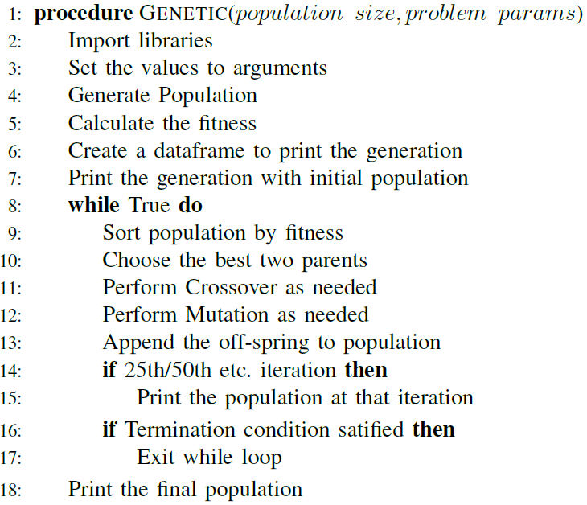
Structure of the Genetic Algorithm Used

Slide 5

Travelling Salesman Problem
NP-hard problem
Aim of TSP is to find the shortest distance to be travelled by a traveler in order to cover all the cities given in the list and return back to the starting point
TSP considers each city as a node V in a graph G and distance between each two nodes u and v, as an edge E with a distance of d(u, v)
The solution will be a directed closed graph covering all the nodes only once.
We have Davis’ Order crossover (OX1) which is generally used for permutation based computations

Slide 6

Coin Change Problem
The aim is to find the sequences or solution sets of coins of certain given denominations in order to reach a sum total value of given money
One-point crossover used here
Random resetting has been used as mutation in the off-spring’s chromosome
The coin change problem has been modified in a smallway in our approach so that it does not provide all thesolutions or total number of possible solutions, but reachesto one of the possible solutions with the help of geneticalgorithm
The value of this fitness function would always like between 0 and 1, with the algorithm generating a solution and halting when the fitness value reaches 1

Slide 7

0/1 Knapsack Problem
This is based on the practical situation where a person has to fill a knapsack with a limited capacity, however with the most valuable items
valuable items. Under a time constraint or a limited budget, the user has to indulge in optimal resource allocation
Here, one should either take a given item as a whole or leave it
In our approach, we begin with the initial population at hand. This is followed by crossover, mutation and finally the selection of the best parents

Slide 8
0/1 Knapsack Problem
Over the coming generations, the process is repeated, barring the initialization of the population
We select 4 species for crossover and apply mutation
Once we append these 4, we finally select the 12 fittest individuals from our population
Using 1-point crossover, we employ bit-flip mutation to accommodate the 0/1 nature of this particular knapsack problem

Slide 9
Conclusion
Evolutionary algorithms have been instrumental over the last decade for a majority of researchers, their adaptations with nature have helped in solving random and heuristic problems
The stochastic probability and the adaptive nature of algorithms owe to the survival of the fittest species in the given population
Although the dynamic nature of our algorithmic approach restricts an optimal condition, we have respective termination conditions that help us otherwise
We found promising results using our approaches on all these problems, this in addition to the adaptive nature of these algorithms promise growing application over the years.

